Slide 1
Lecture 11 Part 2 Back Propagation
Abrar Hasan
Lecturer
Dept. of Software Engineering

Slide 2
1
Back Propagation
<
T
1
>

Slide 3
Back Propagation
<
T
1
>
Remember Gradient Descent?
Gradient descent is an optimization algorithm commonly used to train machine learning models and neural networks.

Slide 4


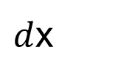

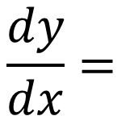
Chain Rule
<
T
1
>
$$\frac{dy}{dx}=$$
$$dy$$
$$da$$
$$da$$
$d$x

Slide 5
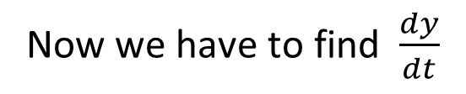
Chain Rule
<
T
1
>
y = 5x + 3
x = t²
Now we have to find $\frac{dy}{dt}$

Slide 6
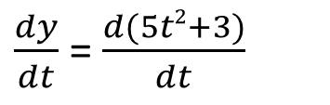
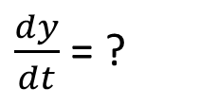
Chain Rule
<
T
1
>
y = 5x + 3
What generally we do,
x = t²
$\frac{dy}{dt}$ = ?
y = 5x + 3
= 5(t²)+3
= 5t²+3
$\frac{dy}{dt}$ = $\frac{d(5t2+3)}{dt}$
=10t

Slide 7
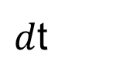
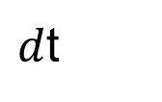
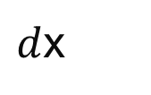
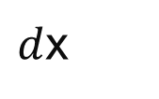

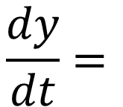

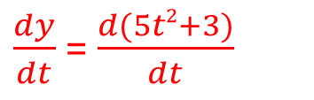




Chain Rule
<
T
1
>
y = 5x + 3
But in chain rule we see
x = t²
Y is function of X
X is a function of T
$\frac{dy}{dt}$ = ?
Instead of doing this
$$\frac{dy}{dt}=$$
$$dy$$
$d$x
$\frac{dy}{dt}$ = $\frac{d(5t2+3)}{dt}$
$d$x
$d$t
$$d$$
$$d$$
$$=$$
$$\left(5x+3\right)$$
*
(t²)
$d$x
$d$t
=5 *2t = 10t

Slide 8
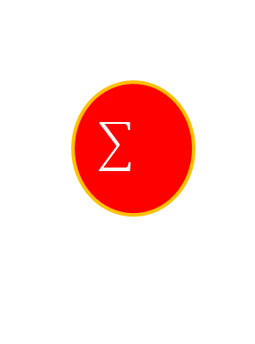
Perceptron
<
T
1
>
b
w1
x1
x2
w2
x3
w3

Slide 9
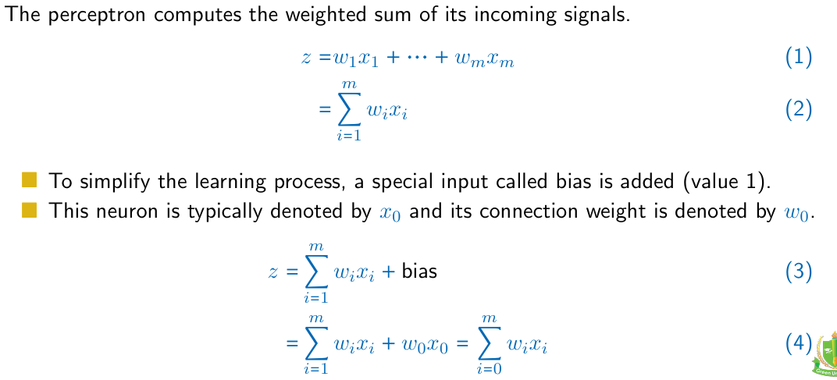
Perceptron
<
T
1
>

Slide 10
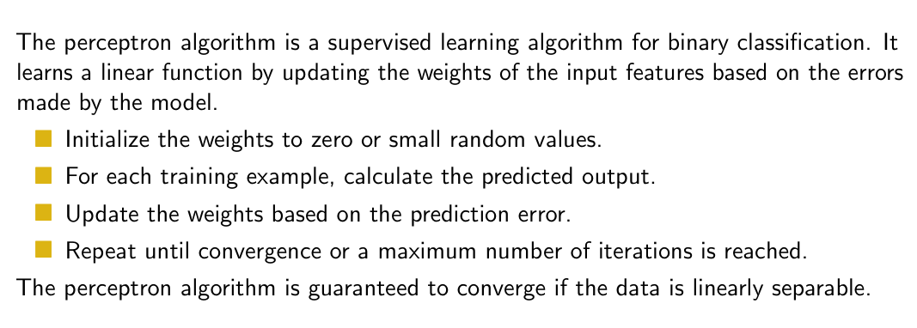
Perceptron
<
T
1
>

Slide 11
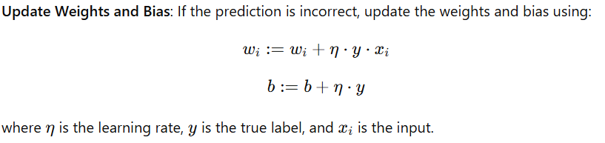
Perceptron
<
T
1
>

Slide 12
Perceptron
<
T
1
>
X1 | X2 | Output
1 | 1 | 1
-1 | 1 | -1
1 | -1 | -1
-1 | -1 | -1

Slide 13
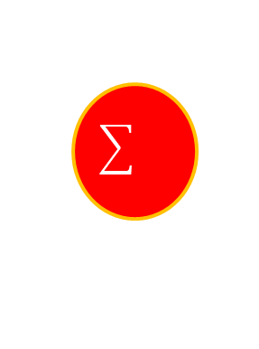
Perceptron
<
T
1
>
W1 = w2= b=0
b
X1 | X2 | Output
1 | 1 | 1
-1 | 1 | -1
1 | -1 | -1
-1 | -1 | -1
w1
x1
w2
x2

Slide 14
Perceptron
<
T
1
>
W1 = w2= b=0
b=0
X1 | X2 | Output
1 | 1 | 1
-1 | 1 | -1
1 | -1 | -1
-1 | -1 | -1
Predicted Value
-1
1
W1 =0
W2=0
1
x₁w₁+x₂w₂+b
= 1 * 0+ 1*0+0
=0

Slide 15
Perceptron
<
T
1
>
So Update the weights
w_{1new}= w_{1old} + (learning Rate) (y)(x₁)
= 0 + (1) (1) (1)
= 1
X1 | X2 | Output
1 | 1 | 1
-1 | 1 | -1
1 | -1 | -1
-1 | -1 | -1
w_{2new}= w_{2old} + (learning Rate) (y)(x₂)
= 0 + (1) (1) (1)
= 1
B_{new}= w_{old} + (learning Rate) (y)
= 0 + (1) (1)
= 1

Slide 16
Perceptron
<
T
1
>
So Update the weights
w_{1new} = 1
w_{2new} = 1
B_{new} =1
X1 | X2 | Output
1 | 1 | 1
-1 | 1 | -1
1 | -1 | -1
-1 | -1 | -1
x₁w₁+x₂w₂+b
= 1 * 1+ 1*1+1
=3
After Sigmoid Predicted Value = 1
Actual Output = -1
So update the weights

Slide 17
Thank You

